Slide 1

PROJECT TITLE
PRODUCT DATA MANAGEMENT OF ENGINE OIL DRAINER USING TEAMCENTER
THIRD REVIEW
Roll No/Student Name
20BME002 / NAVANEETHAN S
20BME012 / JESMOND FRANC R
Guide Name
Dr. S. MADHUSUDHANAN
AP/(SG)

Slide 2
CONTENTS
INTRODUCTION
METHODOLOGY
OBJECTIVE
LITERATURE SURVEY
TEAMCENTER PROGRESS
MANUFACTURING PROCESS
REFERENCES

Slide 3
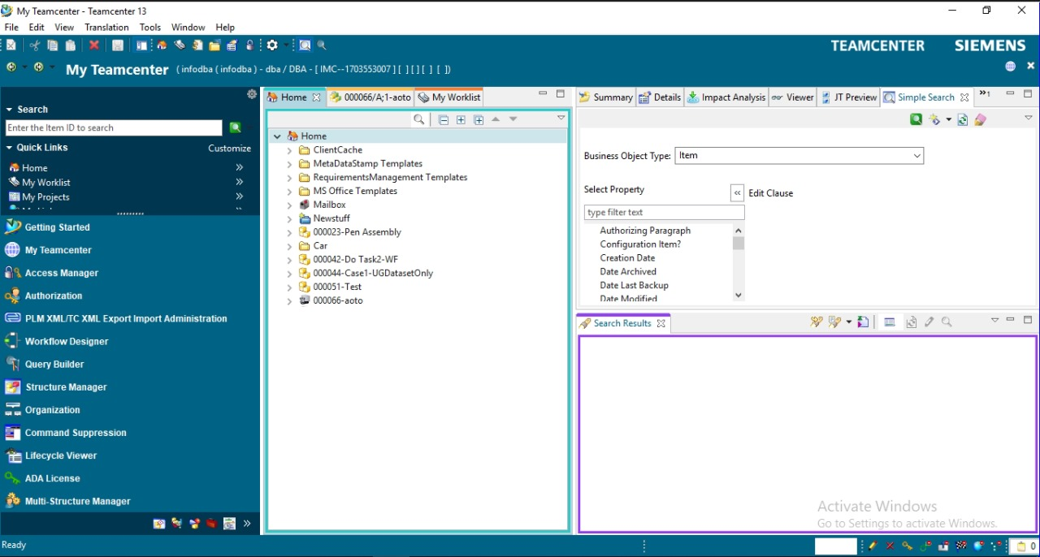
INTRODUCTION
In the process of servicing the two-wheelers, one of the time-consuming processes is draining the used Engine Oil. It usually takes a few minutes to drain completely with the help of gravity.
This increases the time and thereby decreases the productivity of mechanics.
To give a solution for this above problem, we have developed a prototype named Engine Oil Drainer.
In this process of developing a prototype involves saving CAD files, assigning tasks, making variants, and other processes with the help of PLM software named Teamcenter.
Using this software, we can able to track our progress, manage data, creating a Bill of Materials thereby increasing our productivity in finishing a project at a faster rate .

Slide 4
METHODOLOGY
Start
Literature Survey of the Prototype
Teamcenter Learning
Detailed Design
CAE Analysis
End
Manufacturing and Testing
Material and Component Sourcing
Teamcenter Integration with NX Software

Slide 5
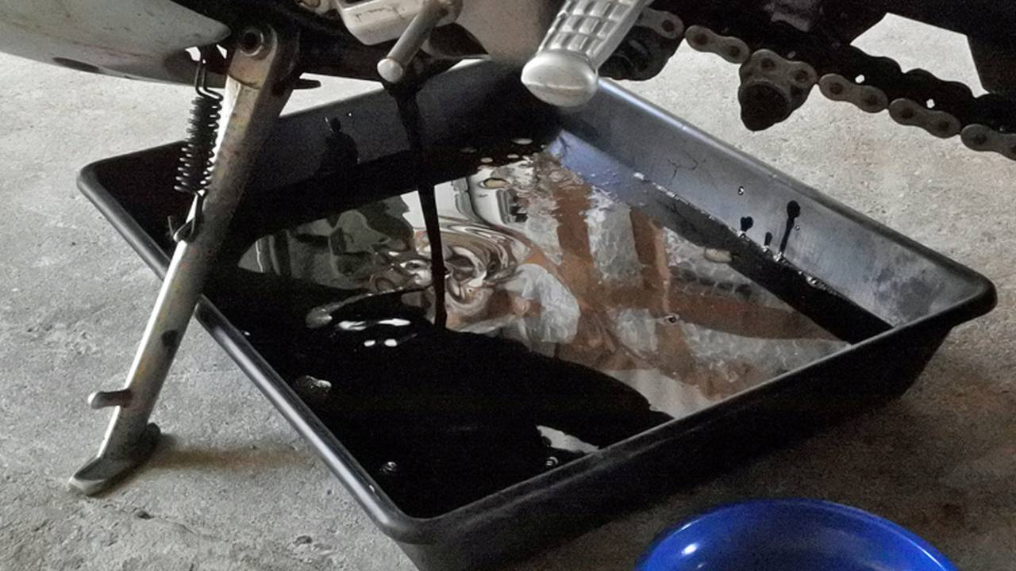
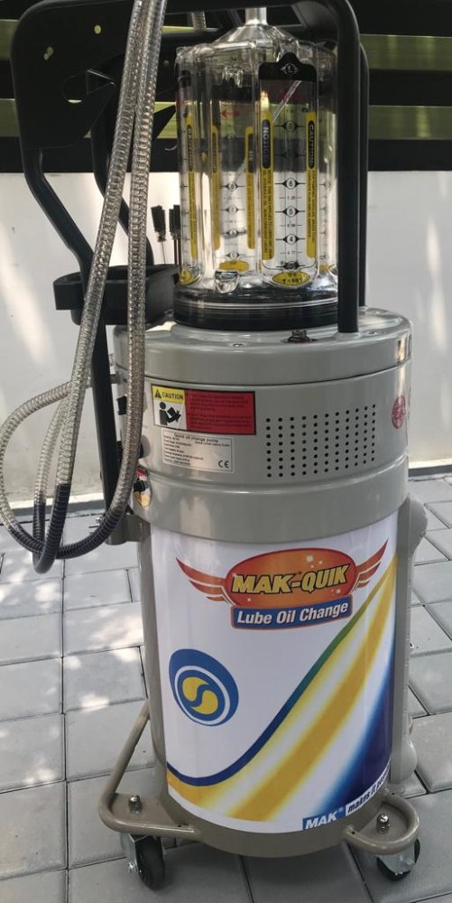
OBJECTIVES
The main objective of the Engine Oil Drainer is to reduce the time
of draining the used Engine oil.
It increases the productivity of mechanics to service the bikes at a
very faster rate.
Existing models only have a suction process which involves the use
of pneumatics.
We have added a vacuum pump to create a vacuum inside
Engine block and suction pump are used to completely drain the
oil in addition to gravity.

Slide 6
LITERATURE REVIEW
S.NO​ | AUTHOR​ | PAPER JOURNAL​ | DESCRIPTION​ | LINKS​
1.​ | Shrikant Baliram Pokale,​ Sawan Sakharam Borul,​ M.K.Rodge​ | Client Side Customization for Checking User Rights in Teamcenter-PLM​ | Talks about client-side customization and allotting user rights for user safety.​ | https://citeseerx.ist.psu.edu/document?repid=rep1&type=pdf&doi=8e1cf3a0b9a23603177e2947a274fd228b7c4cf6​
2.​ | Jaykumar Yoga Mule​ | PLM based Customization for Extraction of NX Assembly from Team center to Local Drive​ | Talks about extraction of NX assembly from Teamcenter to Local Drive.​ | https://research.ijais.org/volume2/number6/ijais12-450381.pdf​ ​

Slide 7
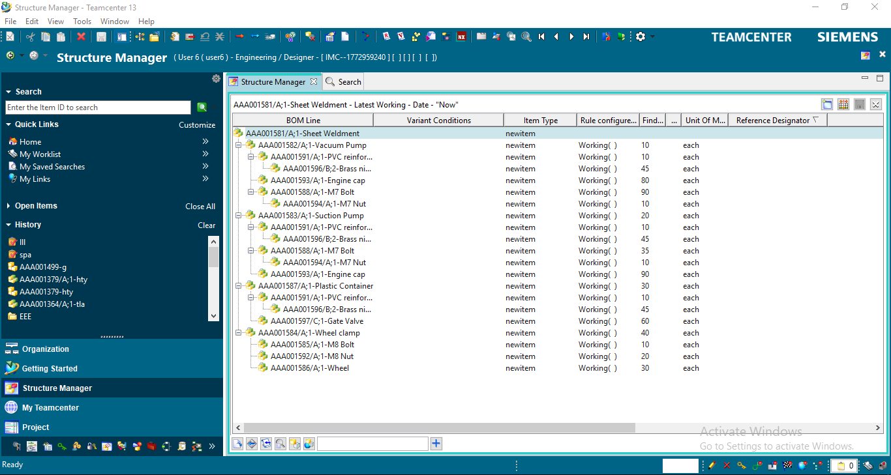
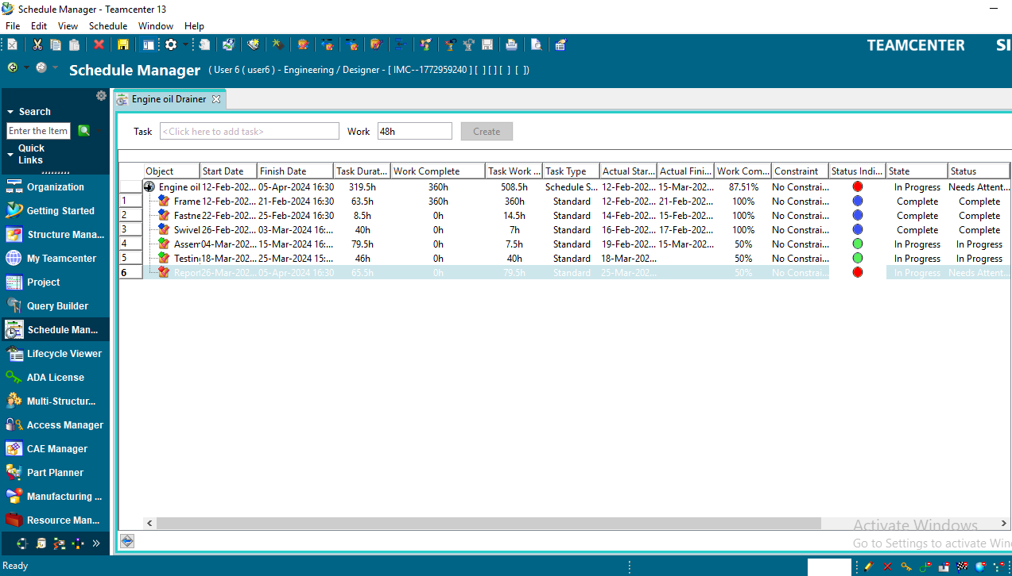
TEAMCENTER PROGRESS
STRUCTURE MANAGER
SCHEDULE MANAGER

Slide 8
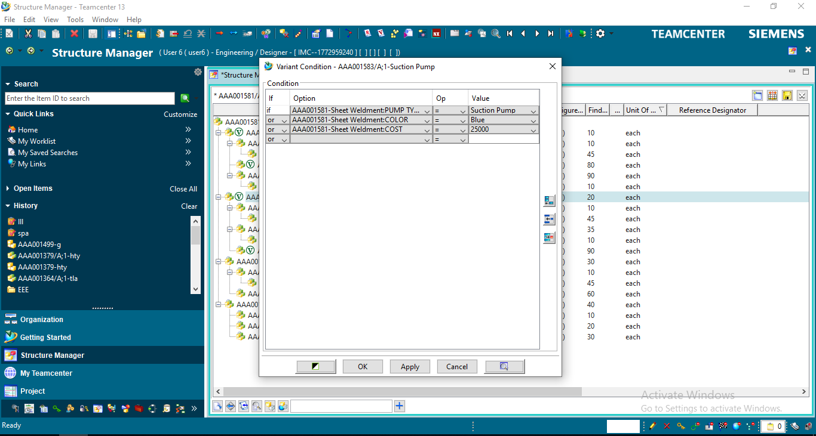
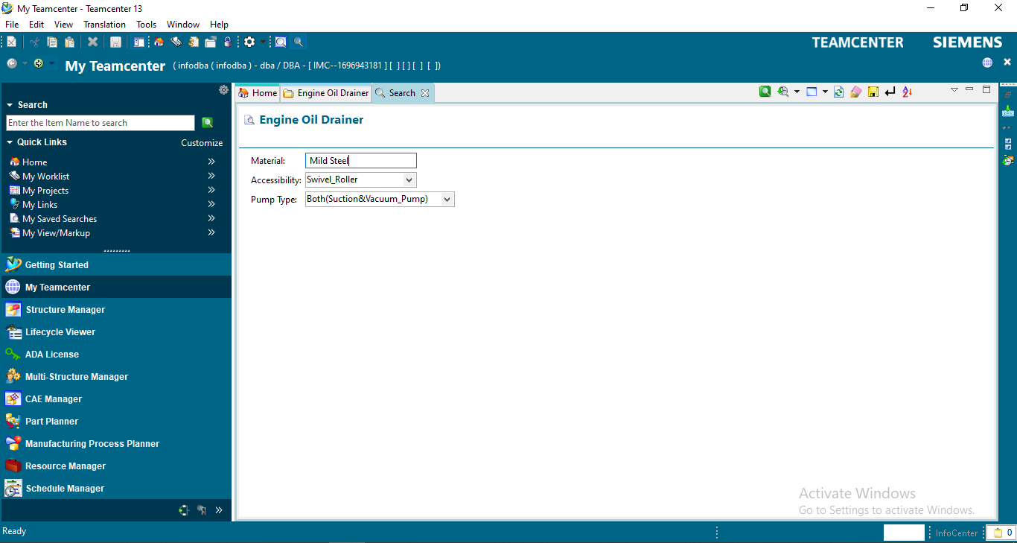
Contd.,
VARIANT MANAGER
QUERY BUILDER

Slide 9
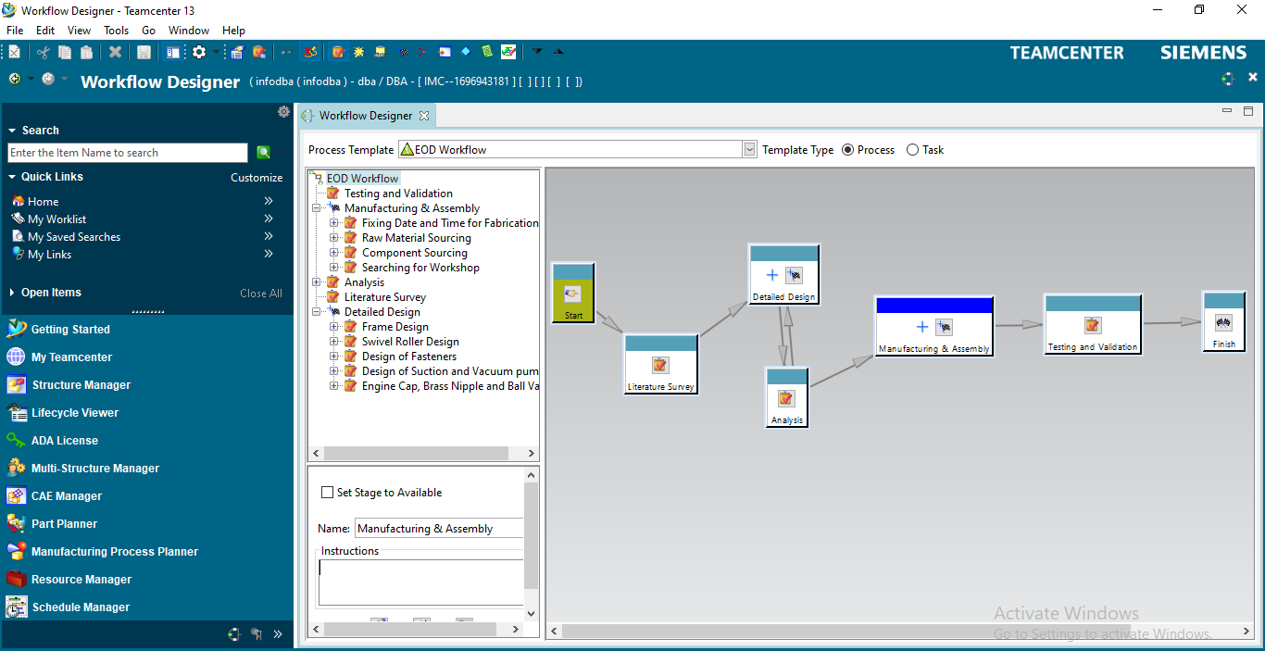
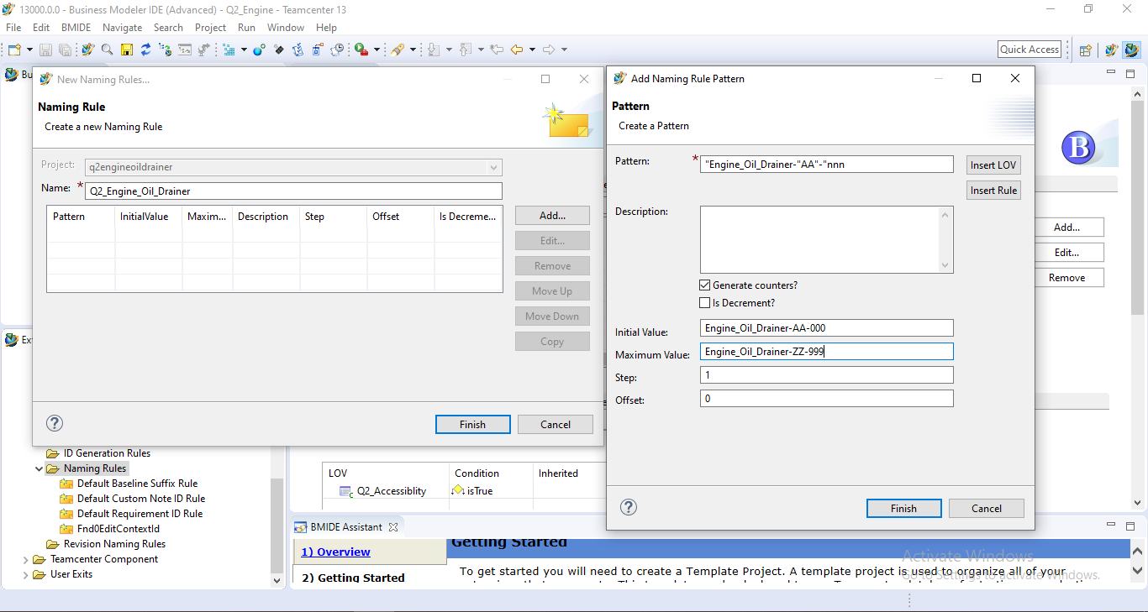
Contd.,
WORKFLOW DESIGNER
NAMING RULE

Slide 10
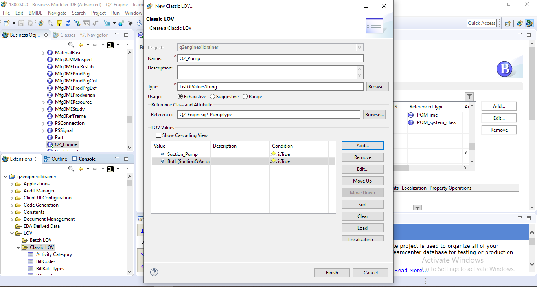
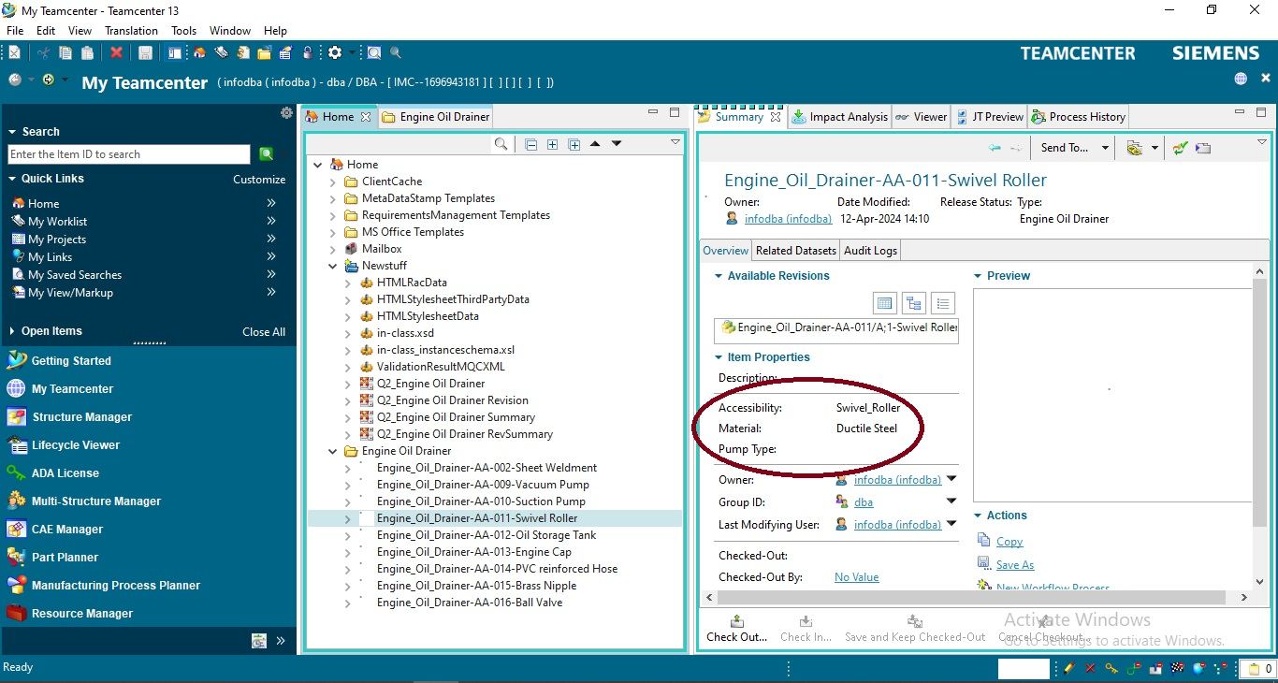
Contd.,
List of Values
Custom Properties (Accessibility, Material and Pump Type)

Slide 11
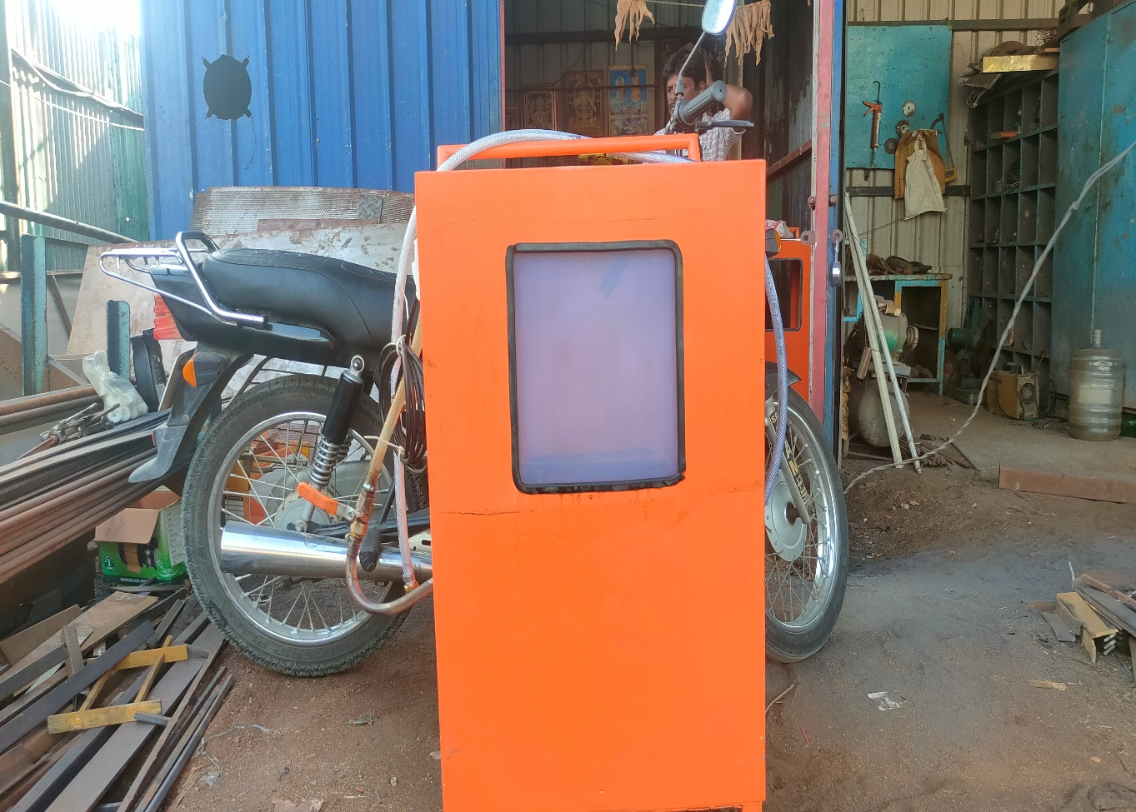
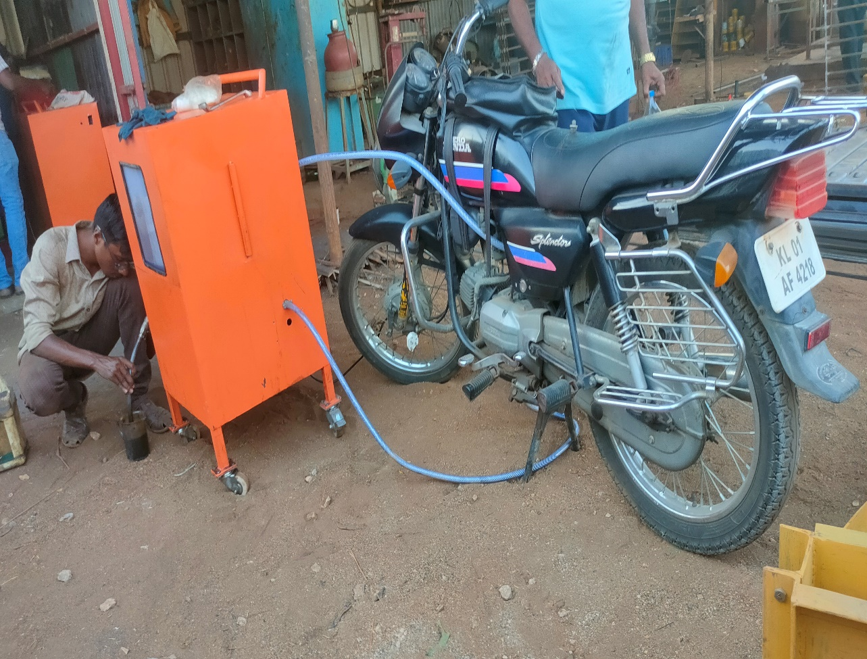
MANUFACTURING PROCESS
Prototype of Engine Oil Drainer
Testing of Engine Oil Drainer

Slide 12
REFERENCES
Mr. Narangale Digvijay Dhondiram “Customization of BMIDE at Customer End as per Business Requirement” Journal on IISRD (International Journal of Trend in Scientific Research and Development),2021, Vol 5(3), pp. 44-49​
https://www.slideshare.net/YogeshIJTSRD/customization-of-bmide-at-customer-end-as-per-business-requirement​
2. Siemens Xccelerator Academy ​
https://training.plm.automation.siemens.com/index.cfm
3. PLM-based Customization for Extraction of NX Assembly from Team center to Local Drive
https://research.ijais.org/volume2/number6/ijais12-450381.pdf

